Slide 1

Independent Contractors 101
Presented by
Quinn Dickason
Andrew Bryan
September 20, 2025
Notes:
Welcome to the Department of Revenue workshop. Our topic today is about license and tax reporting requirements in Washington. My name is Jess.

Slide 2
What we will cover
What is an employee?
What is a contractor?
What is a covered worker?
Workers' compensation
Licensing wizard
Registration
Notes:
Our goal with this workshop is to give you a quick and basic overview becoming a registered business in Washington State, guide you to additional information available on our website, and answer your questions.
In our effort to meet these objectives, today we will give you some background about employee vs contractor. This will include a discussion on the licensing wizard, creating a SAW account, general licensing questions on the business license application, other license and permits, and general tax information.

Slide 3

Employee (W2)
Has no registration or tax obligation with the Department of Revenue
Notes:
An employee is hired by an employer to work regularly for a set salary, under the employer's supervision and control. Employees who are on a W2 and service of an employer have no registration or tax obligation with the Department of Revenue.
The employer is responsible for:
Deciding the time and place of work
Providing the necessary training for the job
Paying the employee at least the current state minimum wage
Paying overtime to most employees who work more than 40 hours per week
Filing workers' compensation insurance (L&I) for all employees, unless they meet the requirements to be excluded from coverage.

Slide 4

An independent contractor
Self employed
Registers with the Department of Revenue
May need to collect sales tax
Files excise tax returns with DOR
Notes:
An independent contractor is a self-employed person or entity contracted to perform work for or provide services to another entity (business) as a non-employee (W2). You are not an independent contractor if you perform services that can be controlled by an employer. An independent contract or 1099 must register with the Department of Revenue for a state license and if you are doing certain services, you maybe required to get a professional license as well or permit, for example a salon-shop license. An independent contractor would have license renewals and tax filing requirements.

Slide 5

Know Thy Workers
(An L&I Perspective)

Slide 6

Workers’ Compensation
Industrial Insurance Basics
Washington is a monopolistic state – employers must acquire workers’ comp through state fund
Benefits for injured workers: medical treatment, wage replacement, disability (partial/permanent)
Benefits to employers: don’t pay claim costs directly, liability protection (no-fault insurance)
Department of Labor & Industries | Small Business Office
Notes:
Some of you may be familiar with worker’s compensation, and others of you may not, so let’s start with a little review of the basics. WA state laws require employers to have workers’ compensation insurance for all their covered workers, and I’ll explore what a covered worker is in just a moment.
So, what is workers’ comp? Simply put, it’s insurance. What does it do? Workers’ comp provides medical treatment and wage replacement to covered workers for injuries that occur in the workplace. Employers pay insurance premiums to Labor & Industries each quarter instead of paying direct claim costs. It’s important to note that WA workers’ comp is no-fault insurance, meaning it provides liability protection from litigation for employers.
Some of you may be wondering: can I get this insurance through my private carrier? No, you can’t. What’s unique about Washington is that we are only one of four monopolistic states in the country, meaning we have a government-owned and operated state fund set up to provide insurance coverage, and Washington employers have to purchase coverage from this state fund. There are no private parties able to compete for the business.

Slide 7

Who Are Covered Workers?
Covered workers almost always include:
Regular employees
Part-time employees
Family members and minors
Spouses
Siblings
Kids
Relatives
Casual, temporary, seasonal labor
Department of Labor & Industries | Small Business Office
Notes:
Let’s start with a fundamental question relating to workers’ compensation: who do you need to cover? Kind of important to know, right?
Specifically, we need to know who qualifies as a covered worker? Or better yet, what do we even mean by covered worker? A covered worker is someone that WA State law requires you to have workers’ compensation coverage for, and those laws assume everyone working for your business is a covered worker unless they meet a strict 6-part independent contractor test (more on that mess in a bit).
So who are your covered workers? They’re your regular employees and part-time workers as well as any of your casual, temporary, or seasonal labor. Essentially, anyone who is not listed as an owner on your business license is going to be considered a covered worker that you need to carry workers’ comp coverage for. And I mean anyone.
So do you know who else that means has to be covered? Your family members and minors, including your spouses, siblings, kids, and relatives or close friends that are just helping out. This is an extremely common area for errors among businesses – they assume any family or friends doing work for the business are exempt when they are not. Despite what others may have told you or what you might have seen on social media, your family members and friends are not exempt from workers’ compensation coverage in Washington.
So in nearly all cases, owners are going to be excluded from that mandatory workers’ compensation coverage, while their family members have to be covered. The only exceptions are family farms or if you set up your business as a sole proprietorship – only then is your spouse considered exempt due to community property laws.
But for LLCs and Corporations, spouses are covered workers unless they are also listed on the business license as owners, meaning you can’t have them working for you without workers’ comp coverage. So if you’re going to start a business as a married couple in an LLC or Corporation, it probably makes sense for both of you to be listed as owners on the business license.

Slide 8
Who Might Be Covered Workers?
People normally exempt, but who may be covered workers:
Owners
Volunteers
Independent Contractors
Department of Labor & Industries | Small Business Office
Notes:
As I mentioned, owners are usually exempt from workers’ comp, but sometimes they want to get optional coverage for themselves, and L&I offers the ability for owners to purchase elective coverage. Now, why would you as an owner wish to do that if you don’t have to?
Well, maybe your private or public health insurance plan doesn’t fully cover work related injuries when you’re working in your own business, or they likely don’t offer any kind of wage replacement if you were to be injured on the job and unable to work for several days, so it is always a good idea to check if elective coverage makes sense for you as an owner. One thing to note with elective coverage, it always goes into effect the day after L&I receives a completed application. It can never be backdated, or people would only buy it after they had already been injured.
I’ve been talking to a lot of businesses lately that seem to think their for-profit business can have volunteers. That is not the case. Only certain organizations can have volunteers and those that are allowed to can also buy optional workers’ comp coverage if they wish. It is the cheapest risk class rate we offer, because it only covers medical treatment, but it does have to be purchased on an all or none basis. So you can’t just cover some of your volunteers.
Before we dive into independent contractors, I do just want to say a little more about volunteers, as lots of businesses have been getting into trouble thinking they can have volunteers lately.

Slide 9
Are Volunteers Covered Workers?
Volunteers can only work for educational, charitable, religious, state/local government, nonprofit organizations.
Volunteers are “covered workers” when:
They receive something of monetary value in exchange for work
What you may provide volunteers:
Maintenance & reimbursed expenses (meals, sleeping quarters)
Stipends, nominal fees, and gifts of appreciation
Department of Labor & Industries | Small Business Office
Notes:
So I volunteer that we dedicate at least one more slide on volunteers.
First of all, it helps to be on the same page of what a volunteer is. And that’s someone who freely gives their time and talents without expectation of pay. For some reason, lately a lot of for-profit businesses think that they can have volunteers. They cannot. Only educational, charitable, religious, government, and nonprofit organizations can have volunteers.
So when might one of your volunteers at a nonprofit be considered a “covered worker” that you need workers’ comp for?
What it boils down it is if your volunteers are receiving something of monetary value in exchange for their work. If that’s the case, they will likely qualify as a covered worker.
If you’re one of the approved organizations that can have volunteers and have done so for a while, you may be aware you can provide things like maintenance and reimbursement expenses for things like meals or lodging while performing assigned or authorized volunteer duties, or things like stipends or gifts of appreciation.
What you want to be very careful of is evaluating whether those maintenance expenses, stipends, and gifts of appreciation could be considered compensation for labor provided. If it looks and feels like they’re being paid for services beyond reimbursement of expenses or reasonable benefits, then they’re going to be considered employees that you have to cover with workers’ comp.
But once again, for-profit businesses CANNOT have volunteers. I realize I’ve said it three times now. I’m hoping it’s like a Beetlejuice situation where now that fact appears and invades your brain every time you hear the word volunteer.

Slide 10
Independent Contractors
Personal Labor Test (Cannot exert control in either instance)
Brings own employees to perform work, OR
Brings heavy or costly specialized heavy equipment and their expertise to operate it
6 Part Test (Must pass all parts to be independent contractor)
Free from direction and control
In business for themselves
Have all required business licenses
Pay state & federal business taxes
Have multiple clients
Maintain own books/records
Department of Labor & Industries | Small Business Office
Notes:
Okay, enough with the opening acts. Let’s get on with the main attraction - Independent Contractors. As you might have guessed, it’s a topic that causes a great deal of misunderstanding. That’s why we’re teaching a course on it at BizFair. Not just because it’s cool, and it obviously totally is.
So what’s confusing about it? Why is the issue of independent contractors a perennial sea of problems and chaos and confusion…and oftentimes citations. So many businesses think that all they have to do is give someone a 1099 and that makes them a contractor. Here’s the truth, folks. It doesn’t matter how many hours they work, how much they earn, or what you call them…it doesn’t matter if they have a matching t-shirt, belt buckle, and coffee mug set that says “World’s Best Independent Contractor”… if they don’t pass the state’s independent contractor test, they’re considered covered workers and that means not only covering them with workers’ comp, but putting them on payroll and granting them a wide assortment of employment laws .
It doesn’t help that it’s possible to be a legitimate contractor from the perspective of the IRS at the federal level, but still not considered one by L&I at the state level for the purpose of workers’ comp.
So what makes a true independent contractor as opposed to an employee you need to cover.
First there’s a personal labor test, which asks are they providing additional workers of their own or major, specialized equipment and the expertise to use it? Either of those conditions, so long as no control or direction is exerted, would pass the personal labor test and that makes them an independent contractor.
If not, then you have to apply the 6-part test listed here, and every one of those conditions have to be met:
Are they free from your direction and control, which can be categorized as behavioral, financial, and contractual?
In business for themselves?
Do they have all required business licenses?
Pay state & federal business taxes?
Do they have multiple clients?
Do they maintain own books/records?
I’ve found that the overwhelming majority of businesses with independent contractors will clearly fail if you start by asking them two quick and easy litmus test questions – does the “contractor” have their own business license and do they serve multiple clients? You’d be surprised how many don’t meet these very basic elements of what a contractor is. Again, they have to pass all six parts of the test (and actually seven, if they work in construction), but those two questions are always how I start.

Slide 11
Independent Contractor Woes
Frequent Misunderstandings and Potential Issues
Red flag: “1099 employee”
Unexpected businesses learn they don’t have independent contractors
Misclassification comes to light through injuries, wage claims, DOSH site visits, unemployment filings
Department of Labor & Industries | Small Business Office
Notes:
Permit me, if you will, to move into my airing of grievances stage about this topic.
A phrase that our office hears far too often and sends shivers of terror down our spines is “1099 employee.” It’s an oxymoron that should indicate to you, as it does to us, that maybe the owner doesn’t understand the difference between an employee, or covered worker, and an independent contractor.
There’s no such thing in labor law as a “1099 employee” or an exemption because you paid them less than $600. That may be accountant or IRS speak, but not labor law. I’ve seen far too many cases where accountants have misinformed their clients and that’s in part, because accountants tend to be focused on federal tax requirements. And those misclassification errors can be very costly to businesses. I’ve seen the assessments! They are not pretty unless you count the phrase “pretty scary.”
Yes, WA’s definition of an independent contractor remains stricter than the federal one and is determined by that 6 part test. Once again, all 6 parts of the test must be passed or the person is considered a covered worker. Independent contractors tend not to be a hot area of audit for the IRS federally because they’re going to get income taxes, social security, and Medicare through an independent contractor’s Schedule Cs & SEs, partnership, or corporate returns.
The only people that should be receiving 1099s are true independent contractors. Because everyone else is a covered worker with a wide variety of payroll deductions for WA-specific things like workers’ comp, unemployment insurance, paid family & medical leave, and WA Cares Fund.
Many times, the ways that business owners find out they did not have actual independent contractors is if a worker is laid off. For example: a business stops using a person they misclassified as an “independent contractor” and they file for unemployment. This can often lead to the agency identifying them as an employee rather than an independent contractor. Or, they’ll get injured, tell the medical provider it was a workplace injury, and a claim will be filed which leads to L&I looking at whether that independent contractor test was passed. Wage complaints will also initiate an inspection or site inspectors from the Division of Occupational Safety & Health will discover a safety violation that commonly leads to businesses discovering they should have been treating what they thought were contractors as covered workers.
The point is there are a whole lot of ways businesses can learn they don’t actually have independent contractors, but covered workers instead. The problem is so incredibly prevalent in Washington because so many people immediately assume workers fit the independent contractor definition. Instead, we all need to work in tandem to shift that thinking so the default for owners is to presume everyone is always a covered worker unless they can prove otherwise.

Slide 12
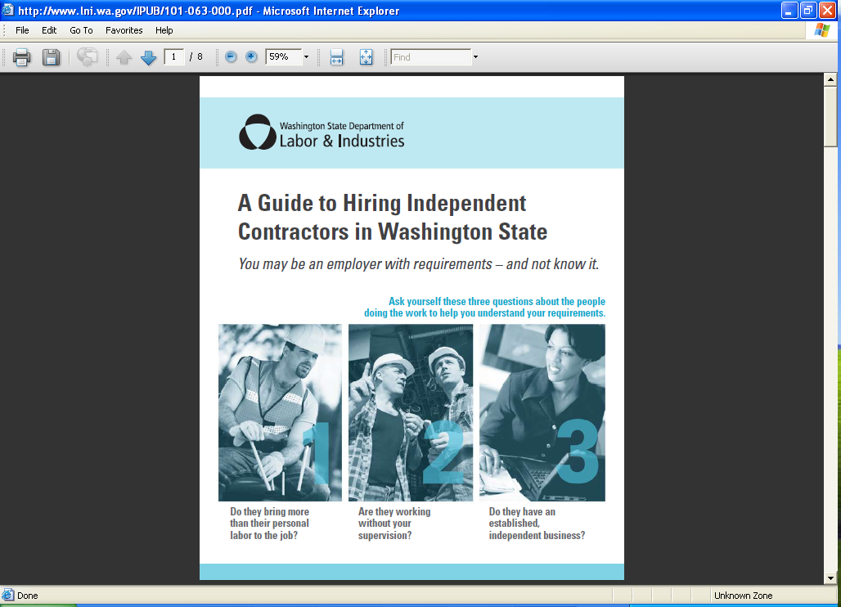
RESOURCE: Independent Contractors
Lni.wa.gov/IndependentContractor
eLearning Class
Independent Contractor Test
Independent Contractor Guide
Determination on a case-by-case basis available:
(360) 902-6868 • Determinations@Lni.wa.gov
Department of Labor & Industries | Small Business Office
Notes:
Since the topic of independent contractors is so thrillingly confusing, L&I has developed a range of wonderful resources to help, all available at Lni.wa.gov/IndependentContractor. We have a free eLearning class, several examples of the test, and this riveting Independent Contractor guide that goes over it in great detail. I’ve brought some for you today to take home if you wish. I’ll even autograph your copy so it transforms from great resource to invaluable prize that you’ll treasure forever.
We also have something called a Determinations Unit that will work directly with you if you still need help determining if a contractor is actually a covered worker or not.
If you need to bring on someone to work in your business, but you really don’t want to hire someone as an employee, consider another entirely LEGAL option:
And that is hiring someone through a temporary staffing or employment agency. In those cases, the person remains an employee of the agency that is loaned out to you, so the agency handles many of the employment requirements. You can even have a specific person in mind go to that staffing agency that you wish to use.

Slide 13

So, You're an Independent Contractor?
Notes:
So now we know what the difference are between an employee and independent contractor, we are going to get into what are the next steps for an independent contractor (business owner).

Slide 14
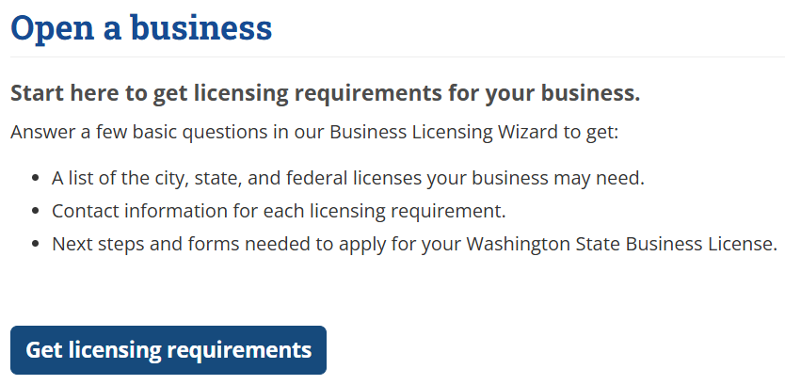
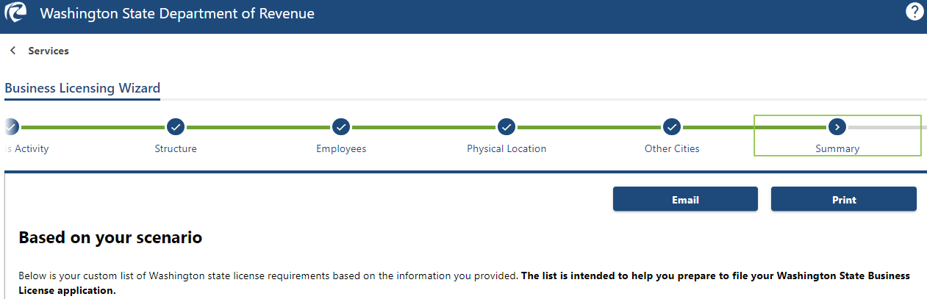
Licensing wizard
dor.wa.gov/licensewizard
Notes:
As mentioned before when becoming a business (independent contractor), you must register with the department. But how do you know what to apply for. We have a great tool you can use, its called the business licensing wizard it has great resources to help you determine the types of endorsements and permits needed on your Washington state business license. The wizard does not register you with the Department of Revenue but will take you through a series of questions and steps. At the end, you get a customized list of licenses and permits needed, given your form of ownership, industry, location, hiring plans, and other key information. This is a great tool to use before you submit your business license application because it will help you understand what you will need to start the registration process with Department of Revenue and information needed for special permits and professional licenses with other agencies.
dor.wa.gov/licensewizard

Slide 15
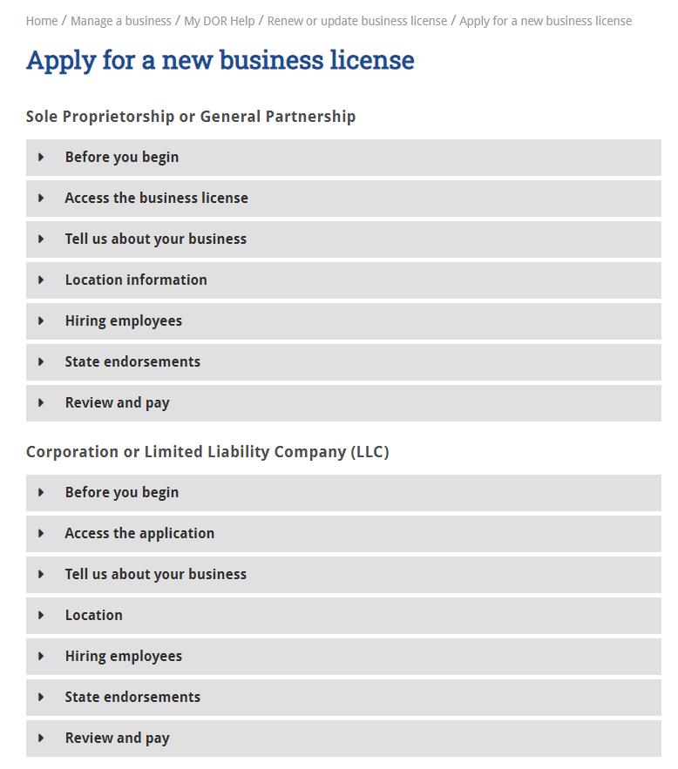
Licensing questions
What you will need before you apply:
Ownership structure
UBI number
Location information
Business activities
Estimated revenue
Business tradename
Hiring plans
dor.wa.gov/Apply
Notes:
OK, lets assume you completed the licensing wizard.
Next, go to our My DOR help page for a list of additional questions you will be asked during the application process.
You can find them at dor.wa.gov/apply. It’s a good idea to have all the information gathered before you begin your application. For example:
Ownership structure
UBI number
Location information
Business activities
Estimated revenue
Business tradename
Hiring plans

Slide 16
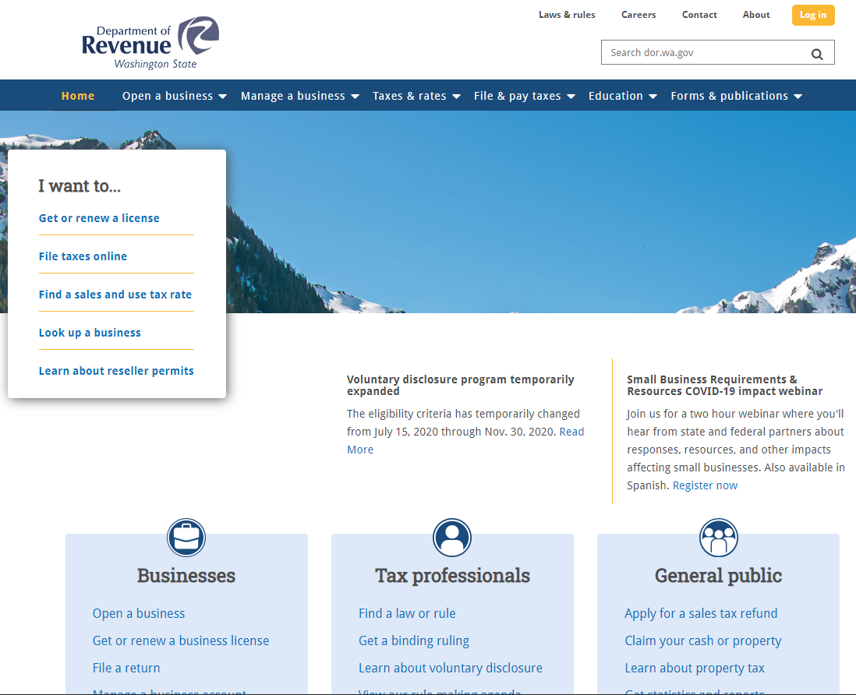
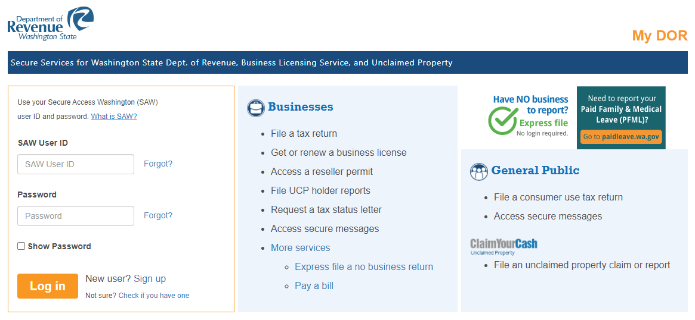
License application
Business Licensing
Secure Access Washington (SAW) Account
dor.wa.gov
Notes:
Once you have all the required information your next step is to complete the actual business license application. Certain entities must be registered with the secretary of state before applying for the business license. For example, an LLC or corporation will need the UBI number that was assigned by the secretary of state. If you will be a Sole Proprietorship or a General Partnership, the Department of Revenue will assign the UBI number after the business license application has been processed.
This is required for Department of Revenue as well as other state agencies, like the Departments of Labor & Industries, Employment Security, Social & Health Services, and Department of Licensing. We are like a one stop shop.
You will file your business license application within your SAW account. Its best to file online. Online applications take up to ten business days to process and paper applications can take up to six weeks to process once received by our agency.
The processing fee for a new business license is $50 and additional fees will vary based on city or state endorsements. You can view the various fees on our website dor.wa.gov.

Slide 17
Other license & permits
Other licenses and permits
Professional licenses
County health department permits
Liquor and cannabis licenses
Notes:
Once you have your UBI and active license, you will contact each agency regarding their professional license requirements. Many businesses must have a professional license or permits.
Hair stylists, estheticians and many others must have a professional license in addition to their state business license. The Washington Dept. of Licensing handles many of the professional licenses.
And food-related businesses require permits from the local county health department.
Those that serve alcohol must have liquor licenses from the Washington Liquor & Cannabis Board.
Your facility may need additional permits, such as building permits, fire safety contact, etc.
And there are others.
Where do you learn about all these?
Remember the Business Licensing Wizard we described earlier?
It will tell you about many of them, but you will also need to check with your city, county, industry associations, advisors, competitors, and others.

Slide 18
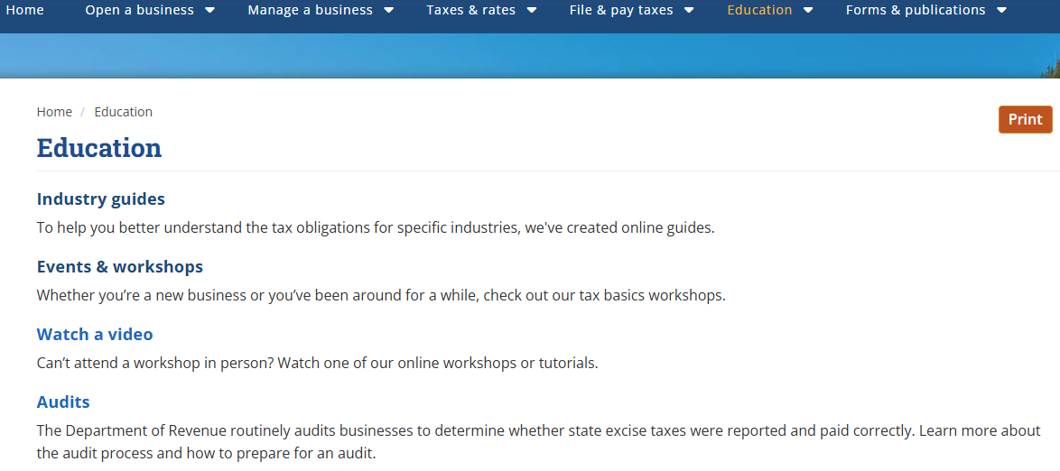
Resources
Tax rulings
Industry guides
Consultation visits
Videos
Workshops
Notes:
You can also submit a request for a binding tax ruling. You can find the form online. Make sure to provide all relevant information related to your question, and you will receive a ruling response usually within 10 business days.
The Department also offers a free tax consultation service. To request a consultation, you will need to submit a pre-consultation visit questionnaire available on our website. A consultant will contact you to discuss your business activities and tax reporting information. After the visit, you will receive a written report with instructions for filing your excise tax return.
We also provide videos and workshops about general tax information that you can find on our website under the education tab.

Slide 19
So, You're an Employer?
(Another L&I Perspective)

Slide 20
Workers’ Comp Requirements
When a business has any covered workers, they must:
Open a worker’s comp account by updating business license at DOR (takes 2 – 4 weeks)
File premiums quarterly at Lni.wa.gov
Must file every quarter if the account is open, even if there are no hours to report
Department of Labor & Industries | Small Business Office
Notes:
So what are your requirements as an employer if you find that you don’t have an independent contractor, but rather a covered worker? Employers have to open a workers’ comp account whenever they have any covered workers, even if they work for just a single hour, and as mentioned earlier, they would start that process by updating their business license at Dept. of Revenue.
Other good things to be aware of - the account typically takes a few weeks to open. L&I is required to contact the owner or whoever completed the application to verify the nature of the business and the work activities to ensure the correct risk class is assigned. This is a helpful for owners to know and expect. One special circumstance to note - if you’re buying a business, L&I cannot open your workers’ comp account until that sale has finalized.
Once we open the account, you’ll be filing premium reports on a quarterly basis, which is easily done at our website Lni.wa.gov. The premiums paid will be determined by the number of hours worked, which employers will need to track. It’s important to note that a report must be filed every quarter, even if there aren’t any hours to report.

Slide 21
REQUIREMENT: Recordkeeping
Independent Contractors
Independent contractor’s legal name
Contractor registration (if building contractor)
UBI number
Certificate of Workers’ Comp Coverage
Written contracts
Employment Records
Worker name, address, and SSN
Daily time records (hourly & piece workers)
Dates of hire and termination
Basis of pay and rate, work week
Financial Records
Check register and canceled checks
Bank statements
Keep All Records for 3 YEARS Plus the Year-to-Date
Department of Labor & Industries | Small Business Office
Notes:
In order to file those workers’ comp quarterly reports, you need some information you’ve collected about your workers, like the payroll and financial records listed here. It is also wise to keep information about any independent contractors you might have used. Even though you won’t report true independent contractors in your filings, this information is necessary for any audits that may occur.
The importance of good recordkeeping cannot be stressed enough. Not only will keeping accurate records save you time and money in the long run, these records are also required by law.
All records should be kept for a minimum of 3 years plus the year to date for workers’ comp purposes in case of an audit or if you need to amend a report.

Slide 22

Small Business Guidance
Washington Small Business Guide
Start, run and grow a business
Payroll processing and payroll calculator
State, federal & local requirements
Best practices, free and low-cost advising & training
Help with permits, approvals, or licenses
Access Small Business Liaisons from 30 state agencies
Guide available in eleven languages & Braille
Department of Labor & Industries | Small Business Office
Notes:
One of the truly fantastic resources I want to share with you today is the WA Small Business Guide. It is available to everyone online at Business.wa.gov and is designed as a one stop shop for everything small business - a roadmap for opening and growing a business, free webinars and workshops, and the spectacular WA Small Business Guide.
The Small Business Guide is divided into chapters related to each business life cycle, everything from planning to bringing on employees with lots of useful compliance information at the state and federal level.
There are tons of great links available for whenever you want to dig deeper into a particular topic.
It’s got everything from tax credits and free business advising to training resources and a super nifty payroll calculator.
You can download the guide in about a dozen different languages.
And! One of my personal favorite and most used resources, here you can find the State Agency Small Business Liaisons list! There is an actual human being at each agency you can reach with your small business questions. 10 outta 10, highly recommend bookmarking this website and downloading the contact list.

Slide 23

L&I Small Business Office
Andrew Bryan, Maggie Hammond & Andrea Muñoz
Visit
L&I Essentials for Business webinars in English & Spanish
Small Business Newsletter
Free resources
One-on-one assistance
Lni.wa.gov/SmallBusiness
1-800-987-0145
SmallBusiness@lni.wa.gov
Department of Labor & Industries | Small Business Office
Notes:
You also have resources directly available to you from L&I. I’m particularly fond of the Small Business Office and its team of dedicated Small Business Liaisons, and not just because I manage this motley crew. The team is comprised of our Assistant Small Business Liaison, Maggie Hammond, as well as Andrea Munoz, our bilingual superstar who offers direct assistance in Spanish. And then there’s ol’ Baldy McBeardface. He’s okay, I guess but, personally, I think he’s overrated.
We aim to be your friendliest friends at L&I, and not only that, we offer a range of services catered to helping you. We all have experience owning and operating a small business and when you come to us, you’re going to have access to one-on-one assistance without any of the fear that often comes with talking to a government agency. Our office is not in enforcement and we don’t report to them. We are all about educating and assisting small businesses, so you can feel comfortable talking to us knowing that it’s a safe space for sharing your issues or concerns.
One service I strongly urge every employer to do is attend our L&I Essentials for Business webinars. We have them in English every month and in Spanish every other month and they cover all the essentials things your business needs to know, essentially, as it relates to L&I in 80 minutes, and for free. I even throw in lots of groanworthy dad jokes.
We also have a newsletter that I highly recommend you sign up for, which will keep you updated of important changes to rules and regulations. Links to both and a bunch of other free resources can be found at a very special page: Lni.wa.gov/SmallBusiness.

Slide 24
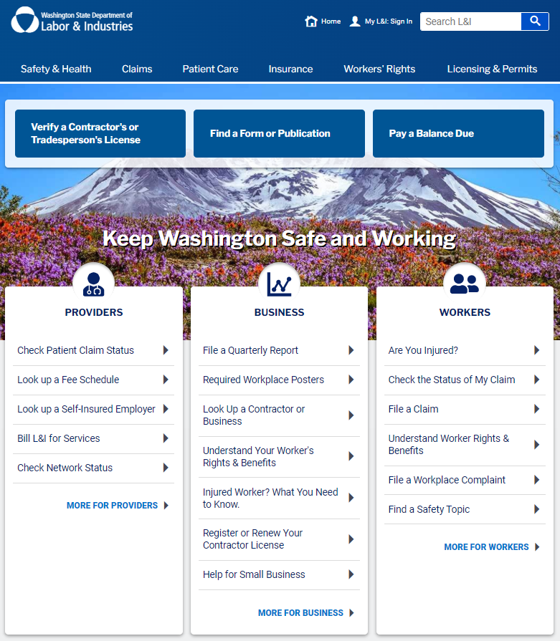
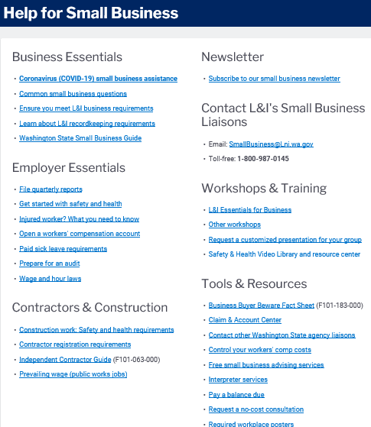
Help for Small Business
Lni.wa.gov/SmallBusiness
Department of Labor & Industries | Small Business Office
Notes:
This is what our wonderful small business page on the L&I website looks like. It’s designed to give you quick access to a wide variety of information and resources from all across our vast website, including a link to subscribe to that very helpful Small Business newsletter (yes, I clearly want you to sign up for that newsletter!)
If while on there, you suddenly feel like the band U2 in the mid-eighties, and still haven’t found what you’re looking for …give us a call or send us an email. After all, we’re your friendly friends at L&I so let us help you when you need it.

Slide 25
For employer requirements and independent contractor questions
Please contact the Small Business Office at SmallBusiness@Lni.wa.gov or 1-800-987-0145
Be safe and merry businessing!
Notes:
Thank you so much for making the time to attend this particular workshop, because I know you wouldn’t have taken this time if you also didn’t take your role as a business owner, and a potential employer, very seriously. So kudos to you.
It’s my hope that you leave this workshop with enough information to move forward with more knowledge and confidence, as well as enough resources to help you fill in any gaps.
With that, you’re done. You’ve enduring the Independent Contractor presentation and found your independence in the end. If you ever have any pressing questions or concerns, please don’t hesitate to contact either of us.
Now dry those tears of knowledgeable joy, and go succeed at businessing. We’ll be waiting for you when you need our help.
We’ll even be waiting right now if you have any questions.

Slide 26
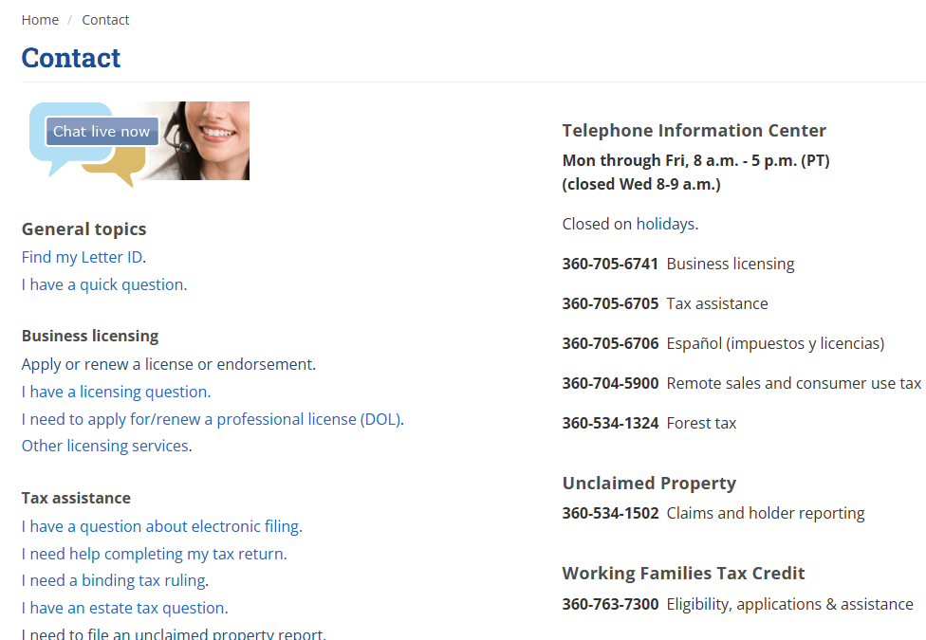
Contact info
Call us at 360-705-6705
Contact us page
Live chat
Secure messaging
Notes:
For in-person assistance, we have 12 offices located around the state. You can review the contact button at the top of our website to see when they are open.
For remote assistance, you can reach us by phone or live chat. We have representatives available to assist you between 8am-5pm, Monday through Friday, except Wednesdays we are open 9am to 5pm. You can use Live Chat for general tax information, but if you need confidential information about your business, you will need to call so we can verify your identity.

Slide 27

Thank you for joining us!
Questions
Notes:
Thanks again for joining us for this workshop today.
Now we will answer as many questions as we can in the time remaining.

