Slide 1
Accounting Fundamentals and Tools
June 2025
Notes:
Title: Accounting Fundamentals and Tools.
Description: Join us for a workshop designed to demystify accounting for small business owners. In this course you will learn about the importance of accounting to a business, review some accounting basics, and will even have the opportunity to see a live demo of an accounting system. Whether you are new to accounting or need a refresher, this workshop will leave a with a better understanding of small business accounting. No prior experience required – just bring your curiosity and questions.

Slide 2
Intro: Ann Zimmerman Certified Business Advisor with the Washington SBDC
Ann was born and raised in Pierce County, and has lived and worked in the area most of her adult life.
Ann’s background is in accounting and finance and has over thirty years of experience in business. Ann has earned her Master’s Degree in Accounting and Tax from WSU, and is a retired CPA.
She as worked in various industries including: retail, construction services, manufacturing, healthcare and not-for-profit.
Ann specializes in assisting her clients in establishing solid policies and procedures while bringing an organization and flow to their operations. Other areas of expertise include: financial analysis, budgeting, organizational effectiveness, management, and business leadership.
“In working with my clients, my main focus is to assist clients to identify their resources, determine how to access them, and how to best leverage those resources toward building a successful, sustainable, and profitable business. I am excited at the opportunity to serve my clients and community through my work at the Washington Small Business Development center by educating, teaching, guiding and advising.”

Slide 3
DISCLAIMER
This class does not represent legal or accounting advice.
Each business has its own unique legal situation and it is recommended that you seek professional and/or legal advice from a licensed professional for the specific needs of your business.
The purpose of this class is to provide small business owners with an education about the basics of accounting.
Notes:
So everything today will be high level. If you want to get into specifics, then you will want to consult with your lawyer, your CPA or your business advisor for additional advise.

Slide 4
Objectives:
The importance of accounting in business
Review Accounting Basics
Review on a high level Accounting Processes and Procedures
Demonstration of an Accounting System
Notes:
Debits, Credits & Demos – Oh My!
In this class you will learn about the importance of accounting to your business, review some accounting basics, and go through a demonstration of an Accounting System.

Slide 5

Why is accounting important to running a business?
Notes:
Does anyone have any thoughts about why accounting is important?

Slide 6

We all have different reasons for owning a business
The common, underlying motive under all our different reasons is:
TO MAKE MONEY!
Dollars is the language that we use to measure our success. Accounting is the function of gathering that data and reporting it.
Notes:
We go into business to make money, support ourselves and build a business of value. If we use dollars as our language, then we need some kind of system and/or structure to report out using dollars to communicate our success.

Slide 7
The Importance of accounting
Dollars is the language that we use to measure our success. Accounting is the system we use to capture that data and provide information to our stakeholders (including ourselves)!
Who are your stakeholders?
And, why do they care whether you are making money or not?
Notes:
Why do we need that data? Why does it matter? Because we have stakeholders who have a vested interest in our business’ performance.
You the business owner
Lender
Investor
Government/Taxing Authorities
Auditors!
Filing a Tax Return. . . If you have a good accounting system with strong procedures in place, filing your taxes doesn’t have to be that hard or overwhelming. If you use it right, and collect accurate data. GIGO Principle. Pound on the ins, pound on the system, and you don’t have to worry about the outs. You still review the outputs (your reports), to validate the accuracy, but the hard work is on the ins and the system. Once you have validated that your reports are accurate, then the reporting is easier. Using QB as a bank register versus using their invoicing system.

Slide 8
The Importance of Accounting - Summary
Accounting supports:
Decision making
Budgets and Financial Projections
Business Growth
Tax Compliance and Filings
Access to Funding
Cash Management
Business Performance Analysis
Legal Compliance and Risk Management

Slide 9

Who will do your bookkeeping?
You?
A Bookkeeper?
An Accountant or a CPA?
Notes:
You? Depending on if you have the room and space to do it? What is your comfort with numbers, your interest in bookkeeping, is it in your wheelhouse? Some have a trauma around math and numbers, and have panic attack at the thought of doing the bookkeeping. And if you have decided that it is not within your wheelhouse, then you can choose a Bookkeeper or an Accountant to handle them for you.

Slide 10
Do I do my own Bookkeeping? (It’s all personal!)
Everyone’s answer will be different and that answer may be different over time.
Questions to ask yourself:
Do you know how to do bookkeeping? Am I willing to learn?
What is your comfort level with numbers and detail?
Do you have enough free time?
How comfortable are you with taxes and regulations?
Can I afford a bookkeeper or accountant?

Slide 11
Bookkeeper versus an Accountant
Bookkeeper
CPA/Accountant
No specific certifications or educational requirements
Focus on day-to day recording of financial transactions
Transactional and administrative role
Provide basic reporting without assurance
File basic tax returns
Required number of educational hours specifically in accounting, pass the CPA exam, and is licensed through the state
Review of financial reports and attest to the accuracy of those reports
In-depth analysis
Provide complex reporting engagements

Slide 12
How do I choose a bookkeeper?
A bookkeeper or accountant should be a trusted member of your professional advisory team.
Interview at least three different candidates.
So your questions will revolve around what is important to you and your business and how to build a trusting relationship.
Hiring an Accountant FAQ's
Notes:
All your questions will vary. You all have your own unique situation and things that matter to you. Questions around what behaviors inspire trust in you. My viewpoint on trustworthy behaviors will be different from yours. Other questions to consider How familiar are they with your industry? How do they like to work? How do they envision the flow of information? What are their keys to a successful client relationship? Are there certain must have’s that you need? What are your needs? What are your deal breakers? I have a link at the bottom of this slide with more details on how to look into hiring an accountant.

Slide 13

Even if you hire a Bookkeeper, you still need to understand your books!
This is your baby!
Notes:
So you’ve decided to outsource your bookkeeping. You still can’t just abandon your business to someone else. That is the fastest way to get yourself in trouble either because you leave the functioning and operating of your business in someone else’s hands and they don’t have the same view point, same interests, nor the same investment in your business as you do. You as the business owner still bears the legal risk, they don’t. This is also a way to open the door to the risk of fraud. When someone, whether they are an employee or a hired bookkeeper, senses that you aren’t tracking or you are an absentee owner, they know they could easily take advantage of you, steal from you and take your money. Just because you hired someone to handle your books, it is not a time to be passive. This is your baby. The operation of your business is your sole responsibility and you alone bear the legal responsibility for your business. You’ve outsourced your books, and when your bookkeeper produces reports. You review them. You use your logic to compare what the reports say versus what your sense is for your business’ activity

Slide 14
Terms/Definitions
Double Entry Accounting
Balance Sheet Equation

Slide 15
Balance Sheet
Assets = Liabilities + Owner’s Equity
A summary listing of your assets and their estimated book value.
How those assets are financed . . . Either by debt or by owner’s contribution
Income Statement
Revenue
Less: Cost of Goods Sold
Gross Margin
Less: Expenses
Net Profit
Net profit is the result of putting your business assets to work. Whatever is leftover as profit is earned by and attributed to the owner.

Slide 16
So let’s talk bookkeeping systems and what they can do for you
Streamlines recordkeeping
Helps reduce errors, missed transactions and seamless reporting
Easier to calculate and file tax returns
Assist with the analysis of your business performance
Can automate some processes i.e. invoicing and payment collections
Can integrate with other business systems i.e. CRM, Timekeeping, etc.
Notes:
A system can offer all of these things, but if you don’t use it properly then you may not be able to realize these benefits. QB – Sales Tax Report, if do not use Invoicing, this report will be $0, and you will have to go to plan B.

Slide 17
So let’s talk Bookkeeping Systems (areas to consider when selecting a bookkeeping system)
Cost
Usability
Features
Integrations
Reporting Capabilities
Scalability
Notes:
Website to Merchant processors to Payment Processors to Bank to Accounting System
Is it scalable? Custom fields available? More Custom Fields than the base model

Slide 18

So let’s talk bookkeeping systems (some examples, and there are more out there)
Quickbooks: www.quickbooks.intuit.com
Freshbooks: www.freshbooks.com
Zohobooks: www.zoho.com
Xero: www.xero.com
Wave Financial: www.waveapps.com
Notes:
Here is a listing, and I included the links for each of these for your convenience on the PPT.

Slide 19
Accounting System Demo

Slide 20
Additional Terms/Definitions
Chart of Accounts
Income Statement/Profit & Loss
Balance Sheet

Slide 21

The Flow of Information and the Accounting Cycle
Transactions
Record the transactions in the system using the Chart of Accounts
Transactions are classified by category through the use of the Chart of Accounts
Produce meaningful reports for making decisions and regulatory filings
Income Statement
Balance Sheet
Statement of Cash Flows
Tax Reports
Other
Notes:
Here we are, to summarize the flow of information and the accounting cycle. Review each point of transaction. Each one of these boxes is a point to evaluate and establish procedures around for your specific business. Every business is different, so your systems and procedures will look different than another business.

Slide 22
Summary: Best Practices
Make sure to have a basic understanding of accounting.
Find and USE an accounting system that fits your business’s needs. Record of all money received and all expenses paid out.
Open a business bank account and keep your business and personal finances separate. Reconcile it every month.
Keep accurate employee and payroll records
Consider hiring an Accountant/Bookkeeper

Slide 23
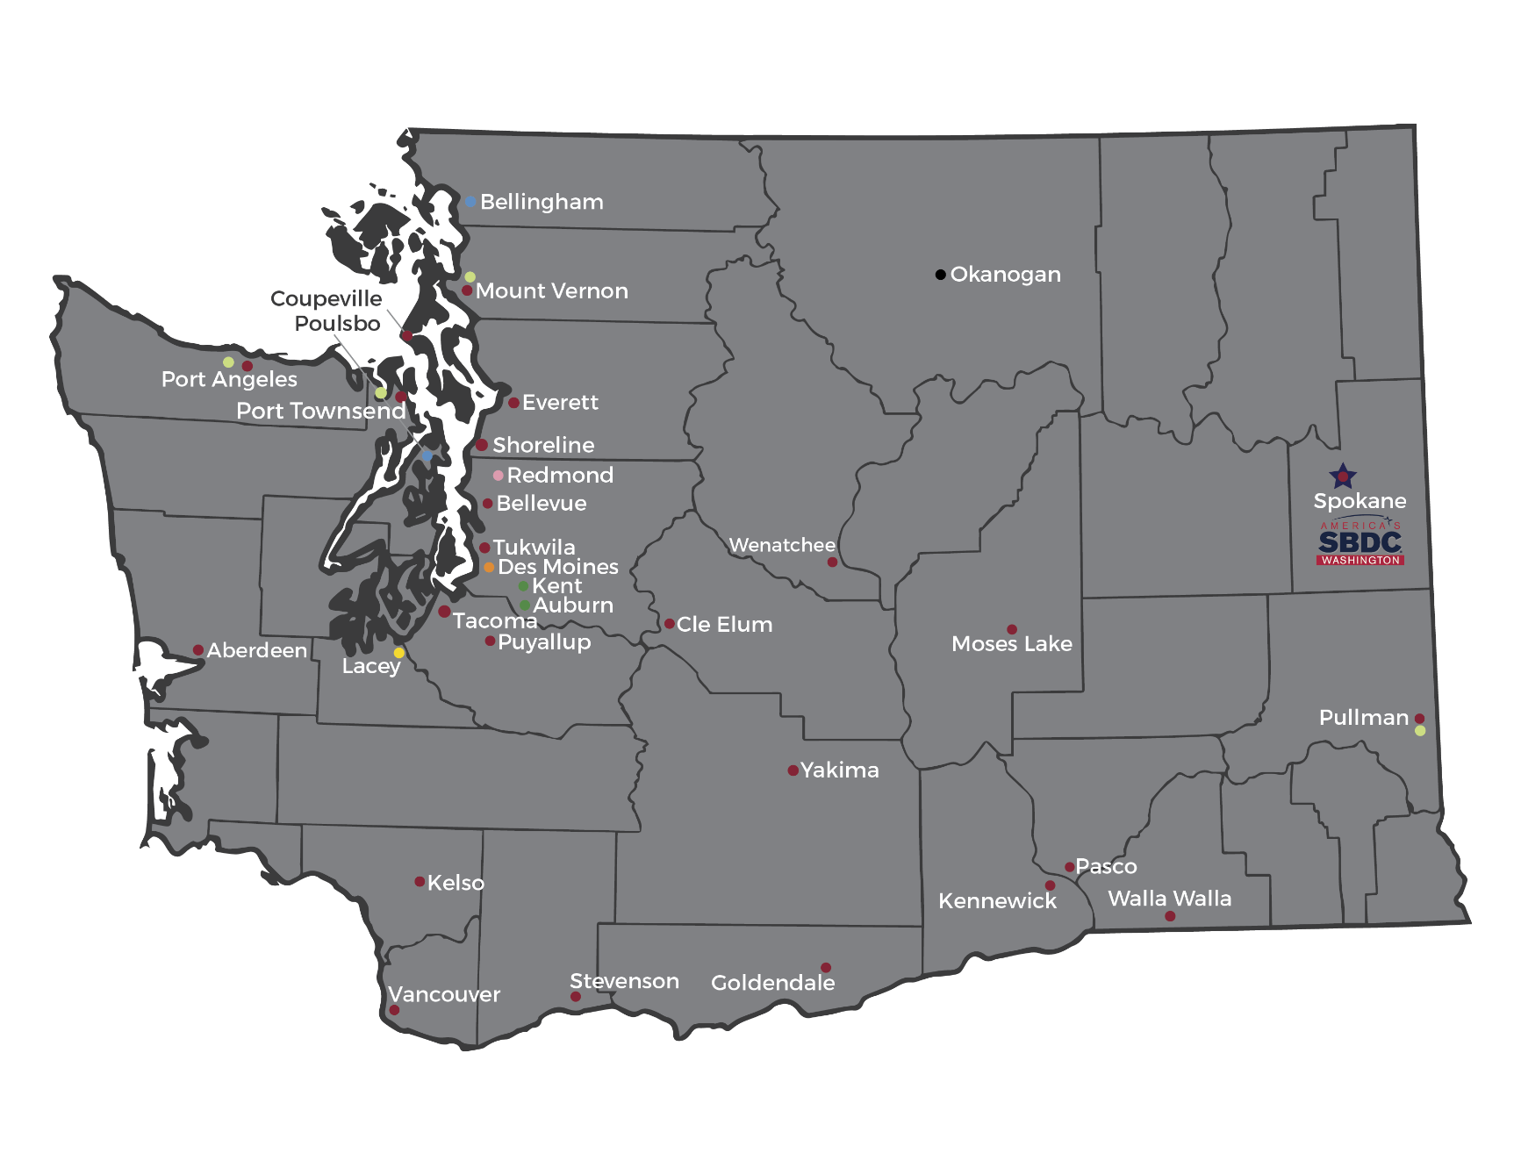
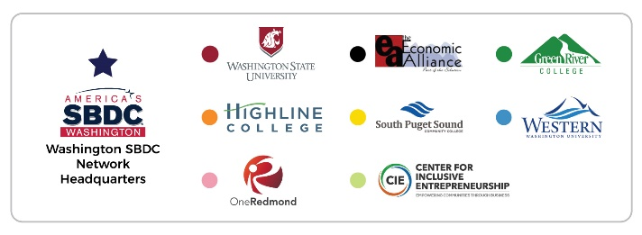
Washington SBDC Locations

Slide 24



Ann Zimmerman
Certified Business Advisor
950 Pacific Ave, Ste 452
Tacoma, WA 98402
253-268-3339 | Ann.Zimmerman@wsbdc.org | www.wsbdc.org
The Washington SBDC network, hosted by Washington State University, is an accredited member of America’s SBDC. Funded in part through a cooperative agreement with the U.S. Small Business Administration, institutions of higher education, economic development organizations and other public and private funding partners.
Reasonable accommodations for persons with disabilities will be made if requested at least two weeks in advance. Email or phone the Washington SBDC.

