Slide 1
Greetings Puyallup!
IRS Resources for Small Businesses
September 20, 2025
Welcome to
BizFair
Notes:
Greetings Puyallup, I am glad to join you today. Many of you may be aware of IRS resources to businesses, but I wanted to remind everyone about the assistance that the IRS wants to provide taxpayers. We are adding new topics daily!
As many of you are business professionals, I suspect you may have heard the common lament of savvy business owners who say “If I knew then what I know now…” Well, if there were a place where you could learn how to run a small business, I’m sure many business owners would benefit.
The IRS has such resources.

Slide 2
Ground Rules: Disclaimer
This deck provides an overview of certain tax provisions for general informational purposes only and is not itself tax guidance.
This deck relies on simplifications and generalizations to convey high-level points about new tax provisions.
Please refer to tax guidance on IRS.gov.
Notes:
Please know that this is only a high-level review for informational purposes. Consult IRS.gov for the current guidelines.

Slide 3

IRS Tools & Resources for Small Businesses
Communications & Liaison Stakeholder Liaison
3
David Higgins
Tax Specialist
Notes:
Most people in the US interact with the IRS as we are the largest government agency that most people ever encounter, but I find most still find it mysterious. You’ve probably done your taxes, but there’s always that lingering thought: Did I get it right? Before I entered the IRS, I felt the same. Now, after 15 years of government service, I hope to be an interpreter from IRS into English.
Since your group specializes in helping businesses, I wanted to show a brief overview of resources available to business owners and entrepreneurs.

Slide 4
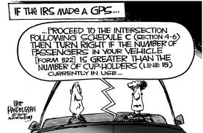
Communications & Liaison Stakeholder Liaison
Notes:
Do you ever feel like the IRS is not speaking plain language? You’re not alone.

Slide 5
Your Presenter
David Higgins
Tax Specialist
15 years working for the IRS
Currently in Communications and Liaison
Previously:
Collections Representative
Revenue Officer
Notes:
I’ve been working for the IRS for quite a while, and I found after many years in collections that the average taxpayer never intends to end up in tax trouble. Most people want to follow the tax code, but they often find the tax code confusing at best.

Slide 6
Today’s material:
Resources & Tax Credits for Small Business
Choosing a Tax Professional
Beware of Scams and Safeguard Information
Start Tax Season Planning Today
Communications & Liaison Stakeholder Liaison
6
Notes:
Conducted annually, National Small Business Week allows the IRS to highlight its efforts to support small businesses. Small businesses play a pivotal role in the nation's economy and the IRS has a variety of resources available to help employers meet their tax responsibilities as well as help their employees.
Tied to the Small Business Administration theme for this year's celebration: Building on America’s Small Business Boom, today’s discussion focuses on:
Resources & Tax Benefits for Small Business
Choosing a Tax Professional
Safeguarding information and watching out for tax-related scams
Start Tax Season Planning Today

Slide 7

Communications & Liaison Stakeholder Liaison
7
Notes:
Whether you are a new or existing small business, you cand find many useful resources on IRS.gov/smallbiz.
Let’s begin with an overview of some of these tools and resources.

Slide 8
A road map from start to finish
8
Sections included on IRS.gov's small business pages:
Starting a Business
Business Structure
Operating a Business
Closing a Business
Notes:
IRS.gov's small business pages map out the entire life cycle of a business and its tax implications. Sections include:
Starting a Business: Basic federal tax information for those starting a business, as well as a checklist to assist in making basic business decisions.
Business Structure: Help in choosing what form of business entity to establish which determines which income tax return forms must be filed.
Operating a Business: Tools and tips on how to get an Employer Identification Number, how to keep good records, and how to file and pay taxes.
Closing a Business: Help navigating the closure of a business from a federal tax perspective; how to take care of employees, which forms to file, which records to keep and what tax related moves need to happen before shutting down.

Slide 9
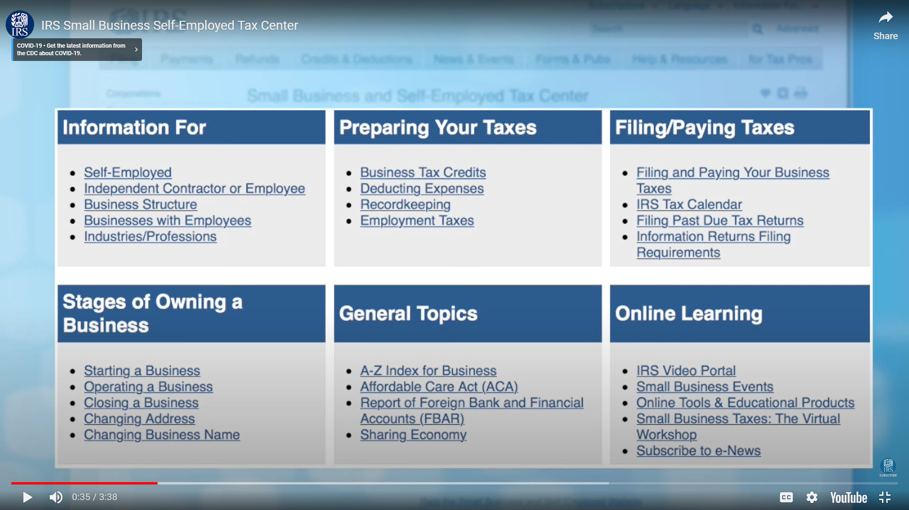
Small Business and Self-employed Tax Center
By Spicypepper999
Notes:
The information is organized into six categories for every phase of your business:
General categories by type of business, Preparing taxes, filing and paying, Stages of owning a business, and a link to online learning which has a multitude of resources for audio and video.

Slide 10
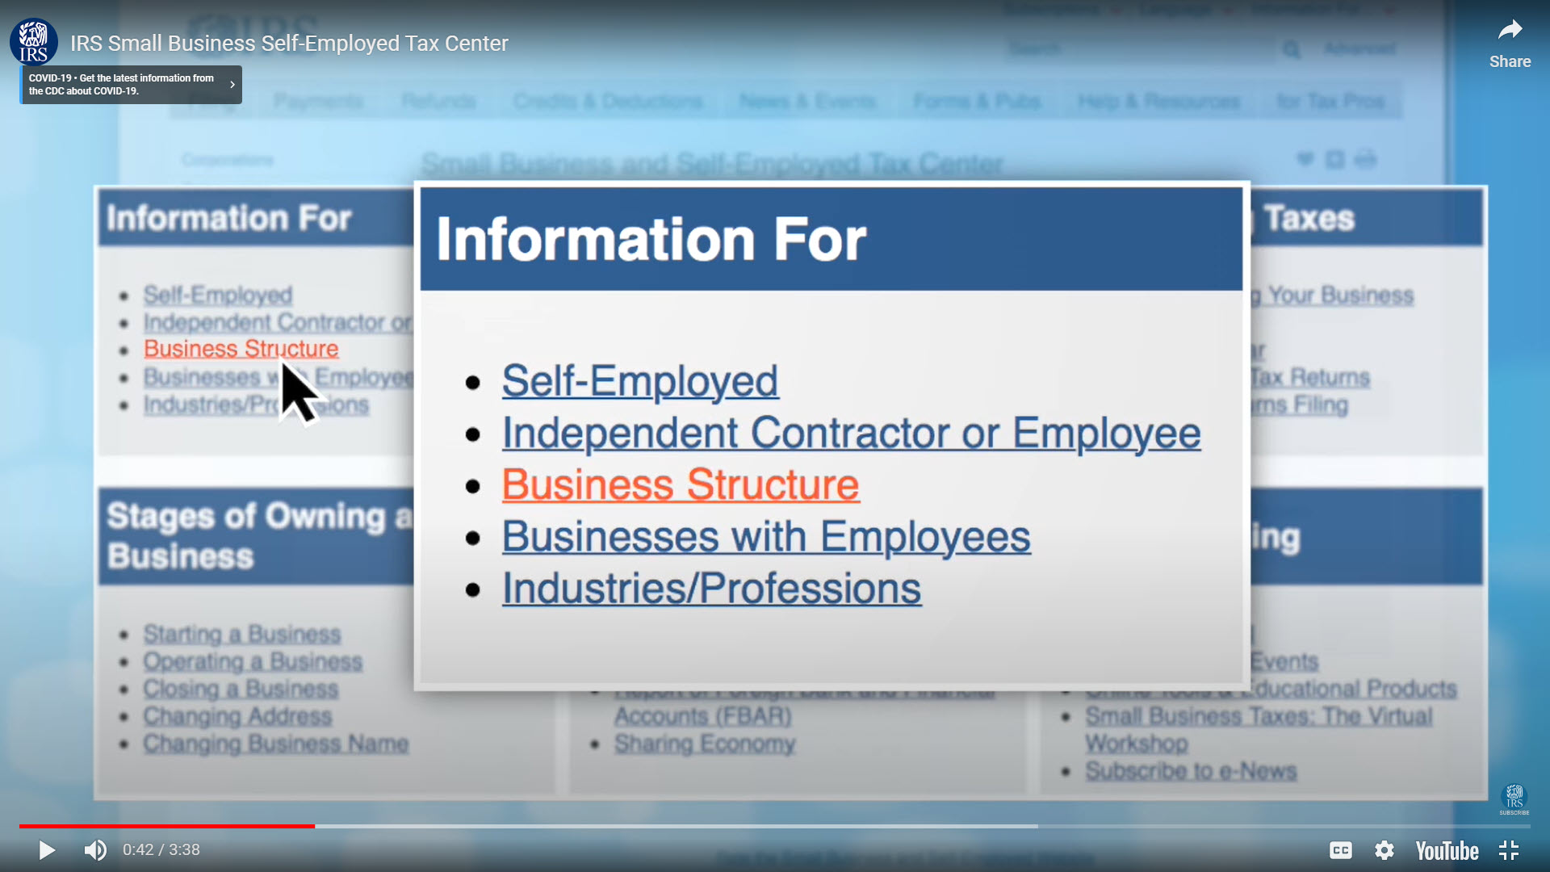
Small Business and Self-employed Tax Center
Notes:
The first section shows links for Self-employed, info to decide whether someone is a contractor or employee, and an explanation of business structures, advice for companies with employees, and specialized info for specific industries.
Tax Centers has resources specific to types of business: restaurants, trucking, Day-care providers, just to name a few.

Slide 11
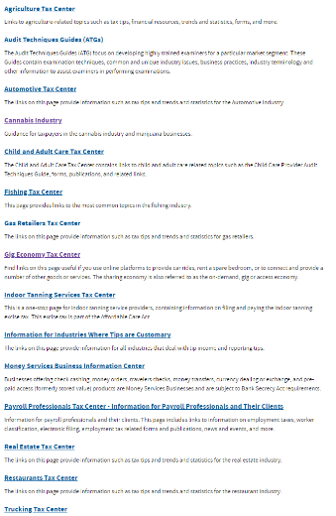
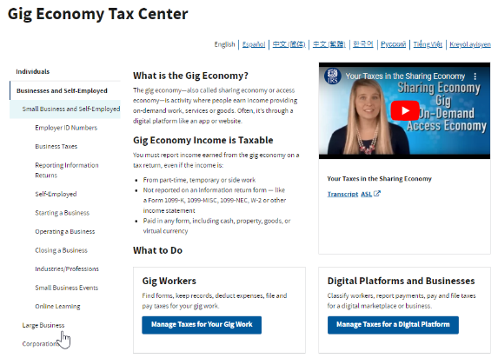
Industry-specific tax centers
11
Publication 5369
Gig economy and your taxes
Notes:
In addition to the overall Small Business Tax Center, IRS.gov also has industry-specific tax centers.
For example, here we see the Gig Economy Tax Center.
Publication 5369 is another resource for Gig workers.
Reminder that the gig economy includes activities such as driving for a ride-sharing company, renting out a room through a rental service, or working for a company that outsources errands and tasks. Money earned through the gig economy is taxable.

Slide 12


Small Business Resources
12
Publication 5801
Tools & Resources for Small Businesses
Publication 5557
A Guide to Starting
a Small Business
Notes:
The next few slides introduce the best publications we have to offer as resources:
Many of the resources I just covered can be found in Publication 5801, Tools & Resources for Small Businesses.
Please consider posting it on your website.
Distribute it to your advisors, clients, members and customers.
Publication 5557 is a resource for new small businesses. It includes links to many different resources on IRS.gov.

Slide 13


Small Business Tax Benefits (cont.)
13
Publication 5858
Employer Educational Assistance Programs can be used to help pay workers’ student loans
Publication 5964
Employer-Provided Childcare Tax Credit
Notes:
Educational Assistance Programs
Employers can help pay their employees’ student loans through an educational assistance program.
Programs have been available for many years but the option to use the program to pay student loans is available only for payments made after March 27, 2020.
This new option is available until December 31, 2025.
In the past, educational programs were generally used to pay for for books, equipment, supplies, fees, tuition and other education expenses for the employee.
Payments $5,250 and under are tax-free per employee per year. Assistance above that amount is taxable as wages.
Childcare Credit
An employer tax credit for up to $150,000 to cover qualified expenses for childcare services.
Employer must have paid or incurred qualified childcare expenditures during the tax year to provide childcare services to employees.
Employers use Form 8882, Credit for Employer-Provided Childcare Facilities and Services to claim the credit.
The IRS launched a new page on IRS.gov explaining the Employer-Provided Childcare Tax Credit. The information is available at IRS.gov/employerchildcare or by searching “employer child care.”

Slide 14
New Tax deductions for Businesses, Working Americans and Seniors
Public Law 119-21
Let us know what you think about the new law.

Slide 15
Qualified business income deduction, QBI
Sole proprietorships, Partnerships, S corporations and some trusts and estates
Also called the Section 199A deduction
Deduction rate at 20% of QBI.
Single filers, threshold to $197,300, and for joint filers, to $394,600.
New minimum deduction of $400 for taxpayers with at least $1,000 of QBI from active trades
Notes:
One of the largest tax benefits for Small Business is like getting 20% off!
Many owners of sole proprietorships, partnerships, S corporations and some trusts and estates may be eligible for a qualified business income (QBI) deduction – also called the Section 199A deduction – for tax years beginning after December 31, 2017. The deduction allows eligible taxpayers to deduct up to 20 percent of their QBI, plus 20 percent of qualified real estate investment trust (REIT) dividends and qualified publicly traded partnership (PTP) income. Income earned through a C corporation or by providing services as an employee is not eligible for the deduction. For more information on what qualifies as a trade or business, see Determining your qualified trades or businesses in the Instructions for Form 8995-A or Form 8995.

Slide 16
Who is Eligible?
Taxpayers, other than C corporations, with qualified business income (QBI) from a qualified trade or business (QTB) or qualified publicly traded partnership (PTP) income and Section 199A real estate investment trust (REIT) dividends may take this deduction, including:
Small Business Owners,
Certain trusts and estates.
Notes:
Who is eligible to take the qualified business income deduction?
Taxpayers (other than C corporations) including individuals, and certain trusts and estates, who have qualified business income from tax years ending after December 31, 2017 from a qualified trade or business or qualified publicly traded partnership (PTP) income and section 199A real estate investment trust (REIT) dividends may be able to claim the qualified business income deduction (QBID).
Partnerships and S corporations do not determine the deduction at the entity level but pass through information necessary for their partners and shareholders to claim the deduction.

Slide 17

New Deduction for Seniors
Effective 2025, many people who are age 65 and older may claim an additional deduction of $6,000. Learn more at: IRS.GOV
Notes:
Deduction for Seniors
New deduction: Effective for 2025 through 2028, individuals who are age 65 and older may claim an additional deduction of $6,000. This new deduction is in addition to the current additional standard deduction for seniors under existing law.
The $6,000 senior deduction is per eligible individual (i.e., $12,000 total for a married couple where both spouses qualify).
Deduction phases out for taxpayers with modified adjusted gross income over $75,000 ($150,000 for joint filers).
Qualifying taxpayers: To qualify for the additional deduction, a taxpayer must attain age 65 on or before the last day of the taxable year.
Taxpayer eligibility: Deduction is available for both itemizing and non-itemizing taxpayers.
Taxpayers must:
include the Social Security Number of the qualifying individual(s) on the return, and
file jointly if married, to claim the deduction.

Slide 18
No Tax on Tips, Overtime, or Car Loan Interest
Effective for 2025 through 2028
Three new tax exemptions for working Americans.
Employees and self-employed individuals
Visit IRS.gov for details
Notes:
Effective for 2025 through 2028,there are three new tax exemptions for working Americans.
Employees and self-employed individuals may deduct qualified tips received. Maximum annual deduction is $25,000; for self-employed, deduction may not exceed individual’s net income (without regard to this deduction) from the trade or business in which the tips were earned.
Individuals who receive qualified overtime compensation may deduct the pay that exceeds their regular rate of pay – such as the “half” portion of “time-and-a-half” compensation -- that is required by the Fair Labor Standards Act (FLSA) and that is reported on a Form W-2, Form 1099, or other specified statement furnished to the individual. Maximum annual deduction is $12,500 ($25,000 for joint filers).
Individuals may deduct interest paid on a loan used to purchase a qualified vehicle, provided the vehicle is purchased for personal use and meets other eligibility criteria. (Lease payments do not qualify.) Maximum annual deduction is $10,000.
“No Tax on Tips”
New deduction: Effective for 2025 through 2028, employees and self-employed individuals may deduct qualified tips received in occupations that are listed by the IRS as customarily and regularly receiving tips on or before December 31, 2024, and that are reported on a Form W-2, Form 1099, or other specified statement furnished to the individual or reported directly by the individual on Form 4137.
“Qualified tips” are voluntary cash or charged tips received from customers or through tip sharing.
Maximum annual deduction is $25,000; for self-employed, deduction may not exceed individual’s net income (without regard to this deduction) from the trade or business in which the tips were earned.
Deduction phases out for taxpayers with modified adjusted gross income over $150,000 ($300,000 for joint filers).
Taxpayer eligibility: Deduction is available for both itemizing and non-itemizing taxpayers.
Self-employed individuals in a Specified Service Trade or Business (SSTB) under section 199A are not eligible. Employees whose employer is in an SSTB also are not eligible.
Taxpayers must:
include their Social Security Number on the return and
file jointly if married, to claim the deduction.
Reporting: Employers and other payors must file information returns with the IRS (or SSA) and furnish statements to taxpayers showing certain cash tips received and the occupation of the tip recipient.
Guidance: By October 2, 2025, the IRS must publish a list of occupations that “customarily and regularly” received tips on or before December 31, 2024.
The IRS will provide transition relief for tax year 2025 for taxpayers claiming the deduction and for employers and payors subject to the new reporting requirements.
“No Tax on Overtime”
New deduction: Effective for 2025 through 2028, individuals who receive qualified overtime compensation may deduct the pay that exceeds their regular rate of pay – such as the “half” portion of “time-and-a-half” compensation -- that is required by the Fair Labor Standards Act (FLSA) and that is reported on a Form W-2, Form 1099, or other specified statement furnished to the individual.
Maximum annual deduction is $12,500 ($25,000 for joint filers).
Deduction phases out for taxpayers with modified adjusted gross income over $150,000 ($300,000 for joint filers).
Taxpayer eligibility: Deduction is available for both itemizing and non-itemizing taxpayers.
Taxpayers must:
include their Social Security Number on the return and
file jointly if married, to claim the deduction.
Reporting: Employers and other payors are required to file information returns with the IRS (or SSA) and furnish statements to taxpayers showing the total amount of qualified overtime compensation paid during the year.
Guidance: The IRS will provide transition relief for tax year 2025 for taxpayers claiming the deduction and for employers and other payors subject to the new reporting requirements.
“No Tax on Car Loan Interest”
New deduction: Effective for 2025 through 2028, individuals may deduct interest paid on a loan used to purchase a qualified vehicle, provided the vehicle is purchased for personal use and meets other eligibility criteria. (Lease payments do not qualify.)
Maximum annual deduction is $10,000.
Deduction phases out for taxpayers with modified adjusted gross income over $100,000 ($200,000 for joint filers).
Qualified interest: To qualify for the deduction, the interest must be paid on a loan that is:
originated after December 31, 2024,
used to purchase a vehicle, the original use of which starts with the taxpayer (used vehicles do not qualify),
for a personal use vehicle (not for business or commercial use) and
secured by a lien on the vehicle.
If a qualifying vehicle loan is later refinanced, interest paid on the refinanced amount is generally eligible for the deduction.
Qualified vehicle: A qualified vehicle is a car, minivan, van, SUV, pick-up truck or motorcycle, with a gross vehicle weight rating of less than 14,000 pounds, and that has undergone final assembly in the United States.
Taxpayer eligibility: Deduction is available for both itemizing and non-itemizing taxpayers.
The taxpayer must include the Vehicle Identification Number (VIN) of the qualified vehicle on the tax return for any year in which the deduction is claimed.
Reporting: Lenders or other recipients of qualified interest must file information returns with the IRS and furnish statements to taxpayers showing the total amount of interest received during the taxable year.
Guidance: The IRS will provide transition relief for tax year 2025 for interest recipients subject to the new reporting requirements.

Slide 19
Business Interest Expense
The limitation on business interest expense deductions is reinstated, starting in 2025.
Limited to the sum of business interest income, floor plan financing interest, and 30% of taxable income
Adjusted taxable income corresponds to earnings before interest, taxes, depreciation, and amortization (EBITDA), rather than earnings before interest and taxes (EBIT) as previously.
Visit IRS.gov for details

Slide 20
Bonus Depreciation
Bonus depreciation rate increased for property placed in service after Jan. 19, 2025 (not otherwise retroactive).
100% for qualified property, and specified plants planted or grafted post Jan. 19, 2025.
100% for qualified production property constructed after January 19, 2025, before January 1, 2029, and placed in service before 2031.
Qualifying property definition expanded to include qualified sound recordings produced after 2025.

Slide 21
Excise Tax on Private Universities and Colleges
The 1.4% excise tax imposed on the net investment income of private colleges and universities is modified into a tiered system based on the institution‘s student-adjusted endowment
Certain smaller institutions will no longer be liable.
The flat rate system has been replaced by a graduated rate structure with three levels:
1.4% for endowments of $500,000 to $750,000
4% for endowments of $750,000 to $2,000,000
8% for endowments over $2,000,000

Slide 22
1099 Reporting
Information reporting (MISC, NEC)
Starting in 2026, the dollar threshold for information reporting increased from $600 to $2,000.
Will be adjusted for inflation after 2025.
De minimis payments by third parties (K)
The original threshold for third-party settlement payment reporting has been reinstated.
Gross payments of $20,000 or more AND more than 200 transactions.

Slide 23


Work Opportunity Tax Credit
23
Publication 5642
Last chance for the Work Opportunity Tax Credit!
Notes:
Work Opportunity Tax Credit (WOTC)
Federal tax credit available to employers hiring individuals from certain targeted groups.
There are 10 targeted groups
The credit has been extended through the end of 2025

Slide 24
TCJA-Related Business Provisions Phasing Down
Research and experimental expenses deduction limits increased to 100% starting in 2025.
Businesses with receipts of $31 million or less may apply the new limits to tax years after 12/31/2021.
Code Sec. 179 expensing and investment limitation increased, with inflation-adjusted amounts. Sec. 179 dollar limitation is $2.5 million in 2025. Investment limitation is $4 million in 2025
Paid Family and Medical Leave Act (FMLA) employer credit extended and modified, starting after 2025.
Employers can claim credits for paid FMLA leave insurance premiums or wages to a qualified employee
Notes:
Purchased for business use: The asset must be acquired for and used in the active conduct of a trade or business.
More than 50% business use: The property must be used for business purposes more than half of the time. The deduction amount is prorated based on the business use percentage.
"New to you": The deduction applies to both new and used equipment, but it must be the first time your business has owned or used the property.
Placed in service during the tax year: The property must be purchased, installed, and available for use in the business by December 31 of the tax year for which you claim the deduction.
Tangible property: This includes machinery, equipment, office furniture, computers, and certain vehicles.
Off-the-shelf software: Readily available computer software that is not custom-made for the business also qualifies.
Qualified real property: Certain improvements to nonresidential real property are eligible, such as roofs, HVAC, fire alarm systems, and security systems.
Other important rules
Business income limitation: You cannot use the Section 179 deduction to create or increase a net operating loss (NOL). The deduction is limited to your business's net taxable income for the year.
Deduction carryover: If the deduction is disallowed because of the business income limitation, the unused portion can be carried forward to future tax years.
Special rules for vehicles: Heavy vehicles like SUVs and trucks with a Gross Vehicle Weight Rating (GVWR) of more than 6,000 pounds but not more than 14,000 pounds are subject to a maximum first-year deduction of $31,300 in 2025.
Bonus depreciation: The Section 179 deduction can be used in combination with bonus depreciation, which for 2025 allows for a 100% deduction on remaining qualifying costs after the Section 179 limit has been reached.
Recapture: If the business use of the property falls to 50% or less at any point during its depreciation period, you may have to recapture part of the deduction.
How to claim: The deduction is elected by filing IRS Form 4562, Depreciation and Amortization, with your tax return

Slide 25
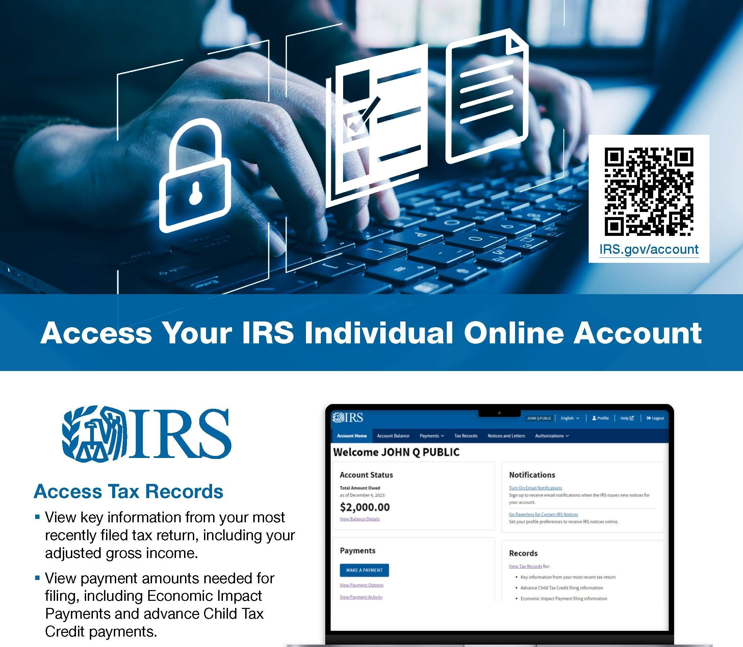
Access your tax account
Access Your Tax Account

Slide 26

IRS Business Tax Account
26
Sole proprietors
View business information on file
Manage business users
View balance due
Make same-day and scheduled payments
View payment history
View tax account transcripts
View tax compliance report
View tax certificate for award use
Notices and letters
Registration for clean energy credits (if eligible)
Partnerships and S corporations
View business information on file
View balance due
Make same-day and scheduled payments
View payment history
Publication 5904
IRS Business Tax Account
Notes:
The IRS now provides a way for many businesses to view their tax information.
At this time, a Limited Liability Company (LLC) that accounts for business income on a Schedule C does not have access to BTA.
A sole proprietor who files business tax returns with an employer identification number (EIN) can access these features:
Profile
View business information on file
Manage business users
Account balance
View balance due
Make same-day and scheduled payments
View payment history
Tax records
View tax account transcripts
View tax compliance report
View tax certificate for award use
Other features
Notices and letters
Registration for clean energy credits (if eligible)
An individual partner or individual shareholder may access their business account if they have both of these:
A Social Security number or an individual tax ID number (ITIN)
At least 1 Schedule K-1 (for partners, from 2012-2022; for shareholders, from 2006-2022) on file
With this, they may access these features for the tax years when they received their Schedule K-1 (access for additional tax years coming soon):
Profile
View business information on file
Account Balance
View balance due
Make same-day and scheduled payments
View payment history
We plan to roll out additional features soon.
Use business tax account if you file business tax returns as a sole proprietor with an EIN. For example: Form 941 for employment taxes or Form 2290 for highway use tax.
Use online account if you file personal tax returns with your Social Security number (SSN) or individual taxpayer identification number (ITIN). For example: Form 1040 for individual income tax.
If you haven't already registered with ID.Me, you'll need to use that process to set up your Business Tax Account or Individual Online Account.
Source: Business tax account | Internal Revenue Service (irs.gov)

Slide 27
We’re Here to Help
Business Help Line 800-829-4933 Individual Tax Help Line 800-829-1040 Taxpayer Assistance Centers, In-person appointments: 844-545-5640
Notes:
Yes, We are here to help. Phone lines are available for any questions or actions you might need to take. We can provide info on how to resolve a variety of issues. Because of demand, be aware of hold time for these services.
Also be aware that we can interpret in many languages on the phone.
A more efficient way to resolve cases issues, is if you can visit one of our taxpayer assistance centers. We set up in-person appointments for you to meet with a tax specialist to help you.

Slide 28
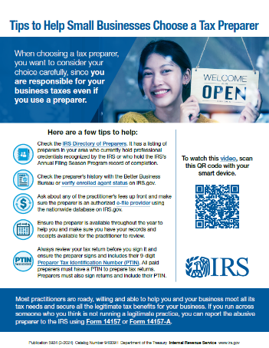
Choosing a Tax Professional
28
Avoid
Paid preparers who:
Claim to get larger refunds
Base fees on refund amounts
Won’t sign the return or won’t give you a copy
Won’t provide a valid IRS Preparer Tax Identification Number (PTIN)
Review tax returns before signing
Confirm the preparer’s year-round availability
IRS.gov “choosing a preparer”
Always
Publication 5924
Tips to Help Small Businesses Choose a Tax Preparer
Search
Notes:
Choosing a paid preparer
One way to avoid mistakes is to use a reputable tax preparer.
Remember, you are still legally responsible for the information on your own tax returns.
Let's review some points you need to be aware of.
Avoid preparers who claim they can obtain larger refunds than others.
Avoid preparers who base their fees on the amount of your refund.
Also, avoid paid preparers who won't sign the tax return or won't give you a copy for your records.
Never sign a blank tax return.
Never sign a completed form without reviewing it and making sure you understand the return.
Consider whether the preparer will still be available to answer questions about the return for months or even years after the return is filed.
The IRS now has a registration and certification process for preparers.
To ensure that you are working with an honest and reputable preparer, make sure that the paid preparer has a valid IRS preparer tax identification number, also known as a PTIN.
All preparers, whatever their professional designation, must have a valid PTIN.
You can find more tips on irs.gov. Simply type “choosing a preparer” in the search box.

Slide 29
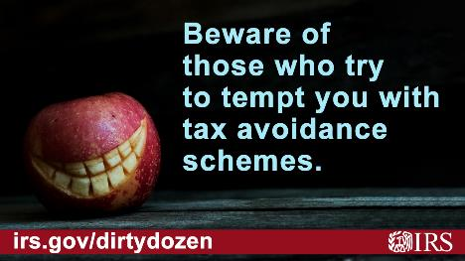
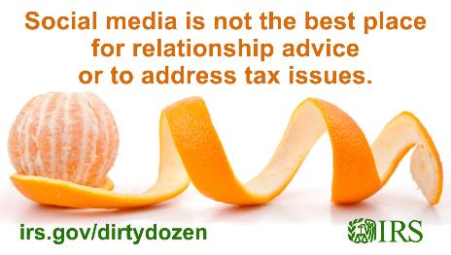
Beware of Scams!
29
Questionable Employee Retention Credit claims
False Fuel Tax Credit claims
Bad tax advice on social media
Notes:
Scam promoters use several different tactics to mislead people who have no chance of meeting the requirements for the Employee Retention Credit (ERC), while charging them excessive fees – often thousands of dollars.
The ERC is a refundable tax credit designed for businesses that continued paying employees during the COVID-19 pandemic while their business operations were either fully or partially suspended due to a government order, or had a decline or significant decline in gross receipts during the eligibility periods.
These questionable ERC claims often put unsuspecting businesses and other entities in jeopardy of penalties, interest and potentially even criminal prosecution for claiming the ERC when they don’t qualify and aren’t entitled to it.
The IRS continues to take special steps to counter aggressive marketing around the ERC.
The IRS is also continuing to accept and process requests to withdraw an employer’s full ERC claim under a special withdrawal process.
Another common scam involving a tax credit: false Fuel Tax Credit claims”
The Fuel Tax Credit is available only for off-highway business and farming use and not for most taxpayers.
Some unscrupulous promoters or return preparers mislead taxpayers about fuel use and create fictitious documents or receipts for fuel.
The IRS has implemented new identity theft screening filters and processing systems that stop many suspicious Fuel Tax Credit refund claims.
Falsely claiming the Fuel Tax Credit is a fraudulent practice with severe consequences, including civil and criminal penalties.
Taxpayers must exercise caution when filing their tax returns and ensure they only claim credits to which they’re entitled.
The last scam I’ll mention today
To report an abusive tax scheme or a tax return preparer, people should use the online Form 14242 – Report Suspected Abusive Tax Promotions or Preparers, or mail or fax a completed Form 14242 and any supporting material to the IRS
Sources:
Dirty Dozen: Beware of aggressive promoters who dupe taxpayers into making questionable Employee Retention Credit claims; risks continue for small businesses, special withdrawal program remains available | Internal Revenue Service (irs.gov)
Dirty Dozen: IRS warns about false Fuel Tax Credit claims; taxpayers should be wary of scammers, heightened review | Internal Revenue Service

Slide 30
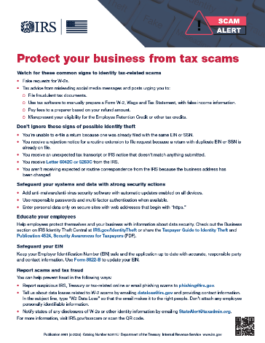
Safeguarding Information
30
Safeguard customer data
Beware of phishing and impersonation schemes
Set security software to update automatically
Back up important files
Require strong passwords for all devices
Encrypt devices
Use multi-factor authentication
Publication 5961 Protect your business from tax scams
Review tips in the business section of Identity Theft Central on IRS.gov
Notes:
The Internal Revenue Service and the Security Summit partners urge businesses to remain vigilant against cyberattacks aimed at stealing their customer's personal information and other business data that can help identity thieves.
Small businesses should safeguard customer data by:
Safeguarding customer data.
Remaining aware of phishing and impersonation schemes.
These can often be cleverly written to fool employees into opening harmful embedded links or attachments.
Be cautions if someone is claiming to be from the IRS. The IRS doesn't initiate contact with taxpayers by email, text messages or social media channels to request personal or financial information.
Businesses and consumers are encouraged to send IRS-related scams to phishing@irs.gov.
All employers should remain vigilant regarding Form W-2 theft schemes. While tax scams evolve and change over time, in the most common versions a thief poses as a high-ranking company executive who emails payroll employees to ask for a list of employees and their W-2s, which contain sensitive tax and financial data. As these scams become more sophisticated, businesses may not be aware they’ve been the victim of a tax scam until fraudulent tax returns begin appearing with employees' names.
I’ll discuss some other scams shortly.
Setting security software to update automatically.
Backing up important files.
Requiring strong passwords for all devices.
Encrypting devices.
Using multi-factor authentication.
The IRS has also published Form 14039-B, Business Identity Theft Affidavit, allowing businesses to proactively report possible identity theft to the IRS. Businesses should file the Form 14039-B if they receive a:
Rejection notice for an electronically filed return because a return already is on file for that same period.
Notice about a tax return that the entity didn't file.
Notice about Forms W-2 filed with the Social Security Administration that the entity didn't file.
Notice of a balance due that is not owed.
Check out the “Business” section on IRS’s Identity Theft Central and see Pub 5461-C, Businesses should watch out for tax-related scams and implement safeguards on IRS.gov for more information.

Slide 31
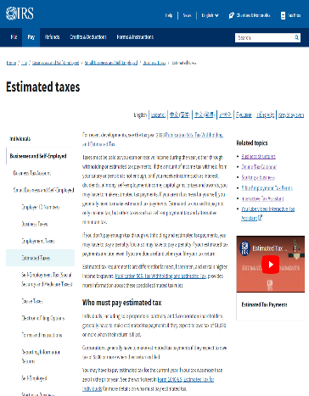
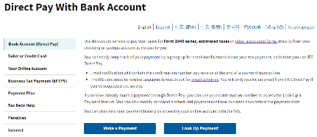
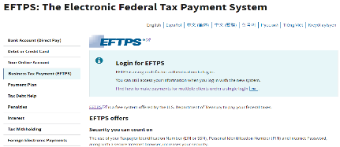
Start Tax Season Planning Today
31
IRS.gov/DirectPay
IRS.gov/EstimatedTaxes
IRS.gov/eftps
Notes:
Get ahead of the game for next tax season by starting your tax preparations now.
We encourage small business owners like you to understand your unique tax considerations when preparing for tax season.
On IRS.gov, find out more about:
Estimated tax payments
Payment options, including:
Direct Pay
Electronic Federal Tax Payment System (EFTPS).

Slide 32
Recommended Reading for Small Business
32
Publication | Description
Publication 15 | Publication 15, (Circular E), Employer's Tax Guide
Publication 334 | Tax Guide for Small Business (For Individuals Who Use Schedule C or C-EZ)
Publication 463 | Travel, Entertainment, Gift, and Car Expenses
Publication 505 | Tax Withholding and Estimated Tax
Publication 535 | Business Expenses
Publication 583 | Starting a Business and Keeping Records
Publication 587 | Business Use of Your Home (Including Use by Day-Care Providers)
Publication 966 | EFTPS – The Secure Way to Pay Your Taxes
Publication 1635 | Understanding Your EIN - Employer Identification Numbers
Publication 1779 | Independent Contractor or Employee
Publication 5557 | A Guide to Starting a Small Business
Notes:
This is a list of helpful publications for small businesses and reference for advisors.
Most are available to browse online.
All may be downloaded in Adobe PDF format and printed.

Slide 33


Communication & Liaison Stakeholder Liaison
David.Higgins@irs.gov
206-946-3318
Notes:
This concludes my presentation.
Thank you for your time today.

